Slide 1
Decision Tree – Entropy and Gini Index

Slide 2
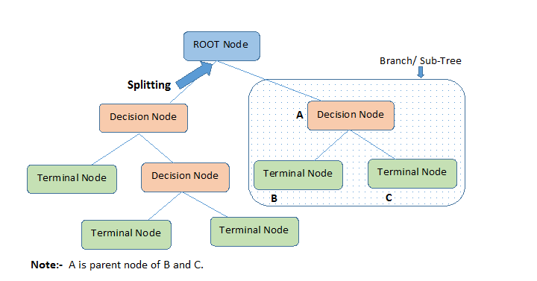

Slide 3
Definitions
Root Node: It represents entire population or sample and this further gets divided into two or more homogeneous sets.
Splitting: It is a process of dividing a node into two or more sub-nodes.
Decision Node: When a sub-node splits into further sub-nodes, then it is called decision node.
Leaf/ Terminal Node: Nodes with no children (no further split) is called Leaf or Terminal node.

Slide 4
Definitions
Pruning: When we reduce the size of decision trees by removing nodes (opposite of Splitting), the process is called pruning.
Branch / Sub-Tree: A sub section of decision tree is called branch or sub-tree.
Parent and Child Node: A node, which is divided into sub-nodes is called parent node of sub-nodes where as sub-nodes are the child of parent node.

Slide 5
Types of Algorithms in Decision Tree
Algorithm used in decision trees:
ID3 – entropy, Information Gain
Gini Index

Slide 6
ID3- Entropy and Information Gain

Slide 7
ID3
ID3 (Iterative Dichotomiser 3)
The core algorithm for building decision trees is called ID3. Developed by J. R. Quinlan, this algorithm employs a top-down, greedy search through the space of possible branches with no backtracking. ID3 uses (Entropy and Information Gain) to construct a decision tree.

Slide 8
Information Gain
The information gain is the decrease in entropy after a dataset is split the basis of an attribute. Constructing a decision tree is all about finding attribute that returns the highest information gain. That is split at the attribute that has the highest information gain.
Information gain is calculated based on entropy.

Slide 9
Entropy
Entropy is used for calculating Information gain.
Entropy : A decision tree is built top-down from a root node and involves partitioning the data into subsets that contain instances with similar values (homogeneous).
ID3 algorithm uses entropy to calculate the homogeneity of a sample.
Entropy is used measuring Impurity
If the sample is completely homogeneous the entropy is zero (If your data is matching- that means no impurity)
If the sample is equally divided then it has entropy of one. (contains equal divisions of different data). No matching data. Then Impurity is high so entropy is 1.

Slide 10
Example of Entropy
Let us say you have a bag of balls.
You grab one ball from the bag and put it on the table. How many ways can you arrange that ball? The answer: one way.
What if we grab two balls and ask the same question? Now there are more ways to arrange the two balls.
We keep doing this until all the balls are on the table. At this point, there are so many ways to arrange the bag of balls, you might not even be able to count the number of ways.
This situation is very much like entropy.
The higher the entropy (meaning the more ways the system can be arranged), the more the system is disordered.

Slide 11
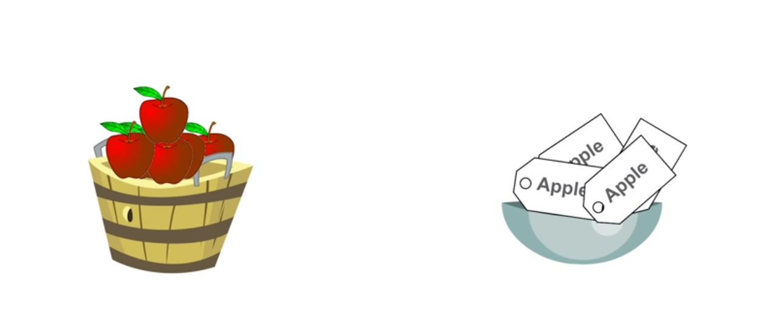
What is Impurity (in Entropy)

Slide 12
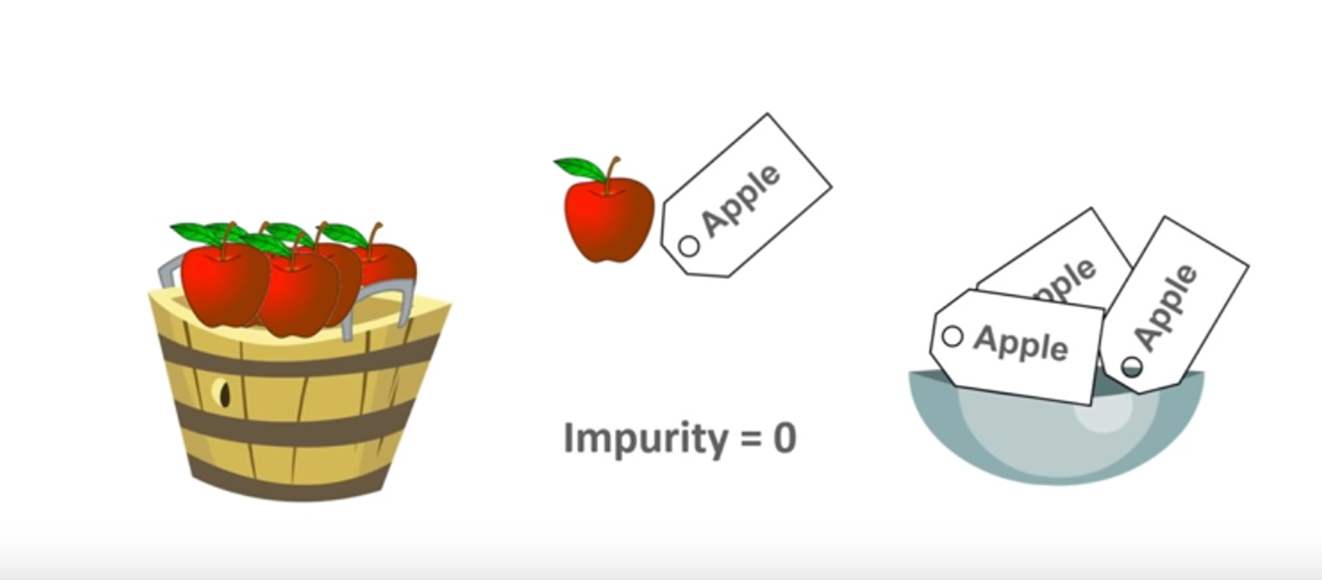
TASK: FRUITS should have matching Labels
Example: Apples should have the same label (Apples).
If you have to pick Apples and Labels from 2 baskets, you will always get matching labels. So the impurity is 0
Impurity is also the degree of Randomness. In the Basket the degree of Randomness is Less, so impurity is zero
Entropy is 0
Because Apple and Apple Label Match

Slide 13
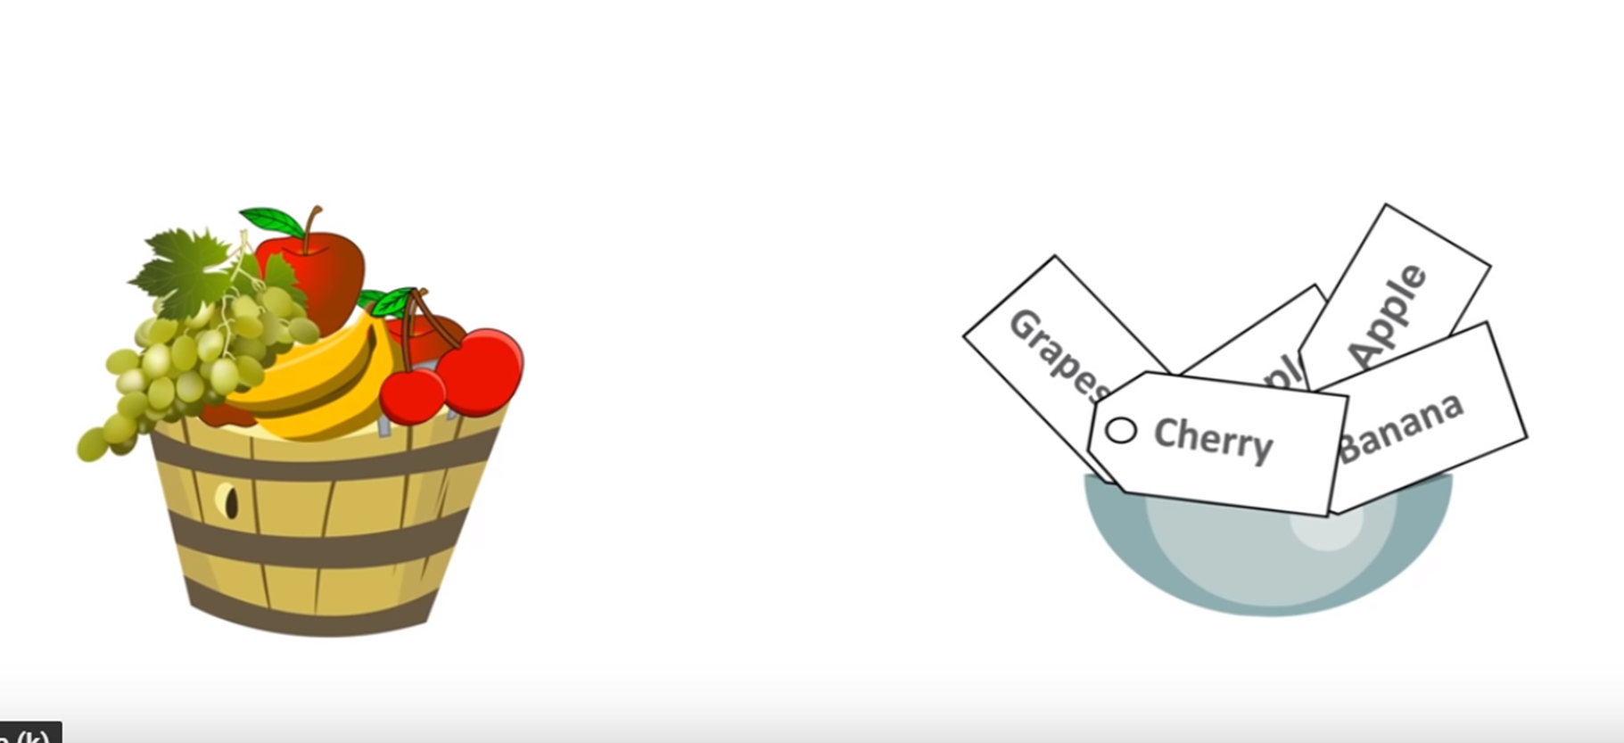
TASK: FRUITS should have matching Labels
Example: Apples should have the same label (Apples).
If you have 2 baskets with different fruits and different labels.
If you have to pick any Random FRUIT or LABEL , it may or may not match

Slide 14
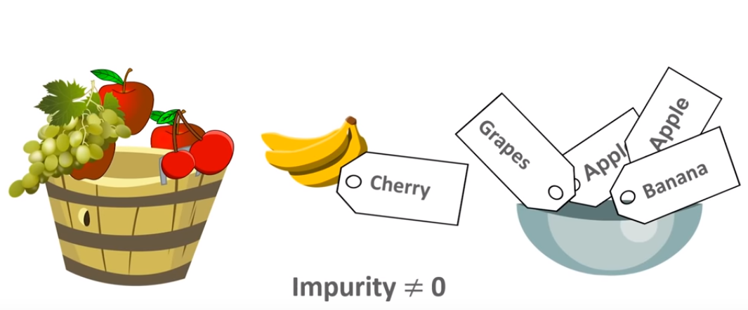
TASK: FRUITS should have matching Labels
Example: Apples should have the same label (Apples).
It may happen a Banana is match with a Cherry Label
So impurity is not equal to zero
Entropy not equal to 0
Entropy is more than 0 or closer to 1
Because Fruits and Label Do not Match

Slide 15
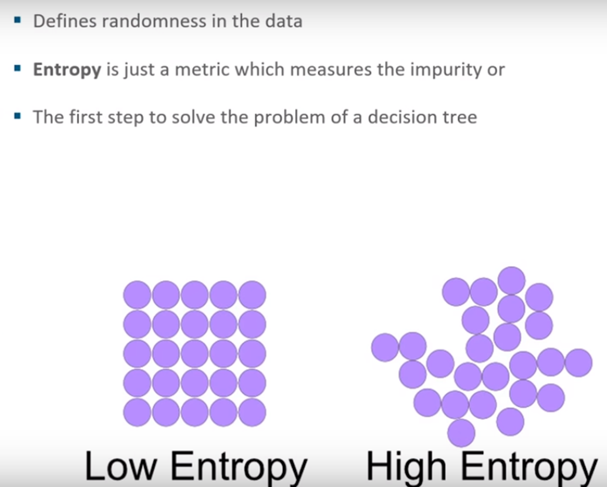
Entropy
Data Contains all Yes
Data Contains similar Types
More Pure
Data Contains mix of Yes and No
Data Contains Mix Types
Less Pure

Slide 16
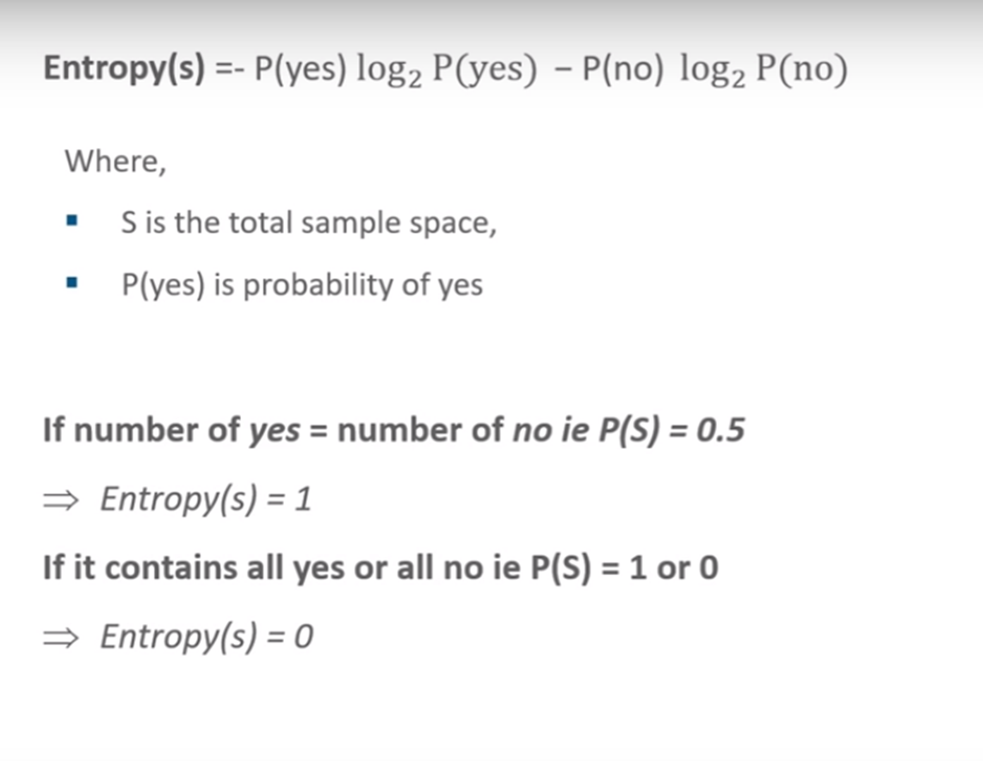
Entropy

Slide 17
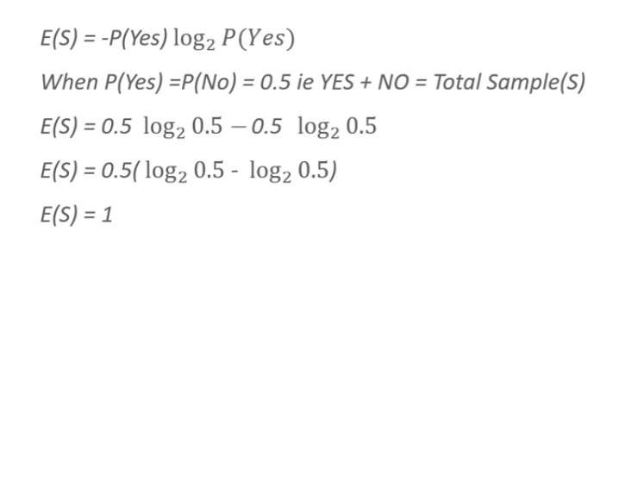
Half Yes, Half No, Entropy =1

Slide 18
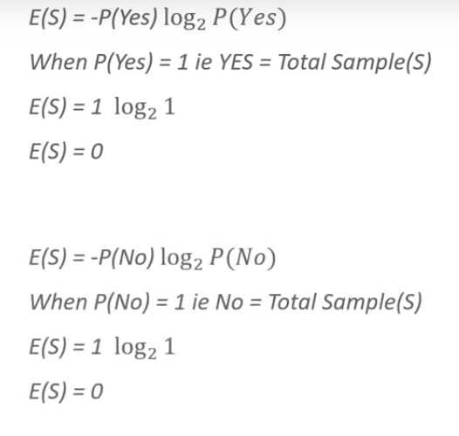
[Total Yes] or [Total No] Entropy] =0
Value of Log 1 is zero
Value of Log 1 is zero

Slide 19
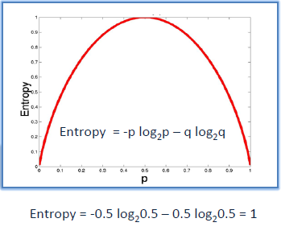
Entropy
Entropy = 0
Entropy = 1
Highly Pure
Highly Impure
Data is Pure, Randomness = 0
Data is of the Same Type, All Yes
Data is Impure, Randomness is high
Data is of the 2 Types, Half Yes + Half No

Slide 20
Entropy

Slide 21
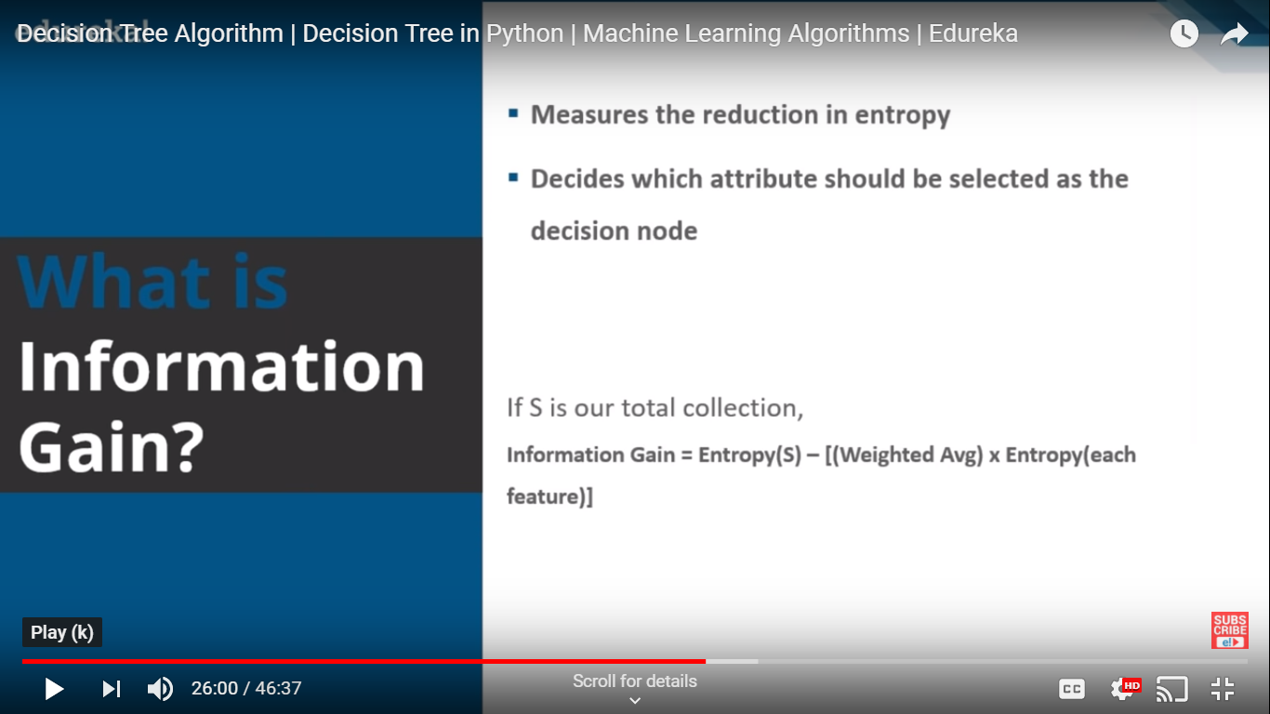
Information Gain

Slide 22
Decision Tree – Play Golf

Slide 23
Decision Tree
To predict if a player will play golf that day based on the weather (Outlook, Temperature, Humidity, Windy).

Slide 24
Predictors
Target
 | Outlook | Temp | Humid | Windy | Play
1 | sunny | hot | high | weak | no
2 | sunny | hot | high | strong | no
3 | overcast | hot | high | weak | yes
4 | rainy | mild | high | weak | yes
5 | rainy | cool | normal | weak | yes
6 | Rainy | cool | normal | strong | no
7 | Overcast | cool | normal | strong | yes
8 | sunny | mild | high | weak | no
9 | sunny | cool | normal | weak | yes
10 | rainy | mild | normal | weak | yes
11 | sunny | mild | normal | strong | yes
12 | overcast | mild | high | strong | yes
13 | overcast | hot | normal | weak | yes
14 | rainy | mild | high | strong | No

Slide 25
 | Outlook | Temp | Humid | Windy | Play
1 | sunny | hot | high | weak | no
2 | sunny | hot | high | strong | no
3 | overcast | hot | high | weak | yes
4 | rainy | mild | high | weak | yes
5 | rainy | cool | normal | weak | yes
6 | Rainy | cool | normal | strong | no
7 | Overcast | cool | normal | strong | yes
8 | sunny | mild | high | weak | no
9 | sunny | cool | normal | weak | yes
10 | rainy | mild | normal | weak | yes
11 | sunny | mild | normal | strong | yes
12 | overcast | mild | high | strong | yes
13 | overcast | hot | normal | weak | yes
14 | rainy | mild | high | strong | No

Slide 26
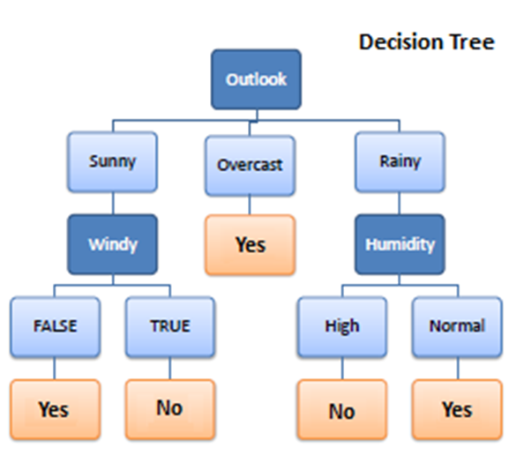
We need to build a Decision Tree, how to Select the Nodes?

Slide 27
Weather Data
 | Outlook | Temp | Humid | Windy | Play
1 | sunny | hot | high | weak | no
2 | sunny | hot | high | strong | no
3 | overcast | hot | high | weak | yes
4 | rainy | mild | high | weak | yes
5 | rainy | cool | normal | weak | yes
6 | Rainy | cool | normal | strong | no
7 | Overcast | cool | normal | strong | yes
8 | sunny | mild | high | weak | no
9 | sunny | cool | normal | weak | yes
10 | rainy | mild | normal | weak | yes
11 | sunny | mild | normal | strong | yes
12 | overcast | mild | high | strong | yes
13 | overcast | hot | normal | weak | yes
14 | rainy | mild | high | strong | No

Slide 28
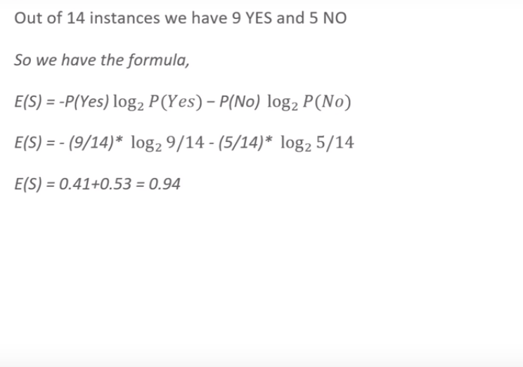
Compute Entropy Of Total DataSet Rows = 14
 | Outlook | Temp | Humid | Windy | Play
1 | sunny | hot | high | weak | no
2 | sunny | hot | high | strong | no
3 | overcast | hot | high | weak | yes
4 | rainy | mild | high | weak | yes
5 | rainy | cool | normal | weak | yes
6 | Rainy | cool | normal | strong | no
7 | Overcast | cool | normal | strong | yes
8 | sunny | mild | high | weak | no
9 | sunny | cool | normal | weak | yes
10 | rainy | mild | normal | weak | yes
11 | sunny | mild | normal | strong | yes
12 | overcast | mild | high | strong | yes
13 | overcast | hot | normal | weak | yes
14 | rainy | mild | high | strong | No
E(S) = 0.94
Entropy of the entire datset = 0.94

Slide 29
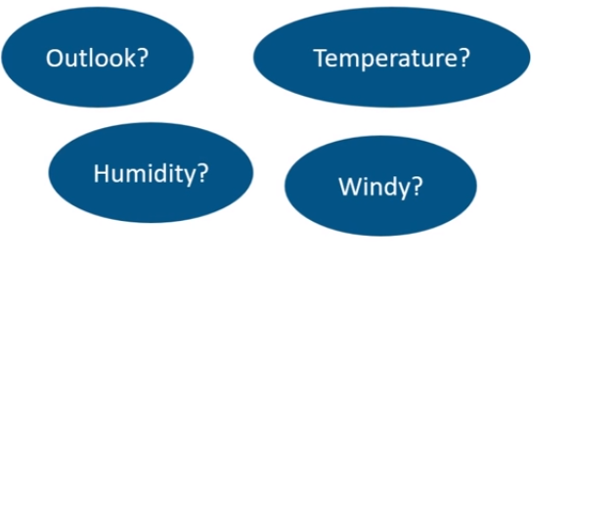
Which Node to select as Root Node
 | Outlook | Temp | Humid | Windy | Play
1 | sunny | hot | high | weak | no
2 | sunny | hot | high | strong | no
3 | overcast | hot | high | weak | yes
4 | rainy | mild | high | weak | yes
5 | rainy | cool | normal | weak | yes
6 | Rainy | cool | normal | strong | no
7 | Overcast | cool | normal | strong | yes
8 | sunny | mild | high | weak | no
9 | sunny | cool | normal | weak | yes
10 | rainy | mild | normal | weak | yes
11 | sunny | mild | normal | strong | yes
12 | overcast | mild | high | strong | yes
13 | overcast | hot | normal | weak | yes
14 | rainy | mild | high | strong | No

Slide 30
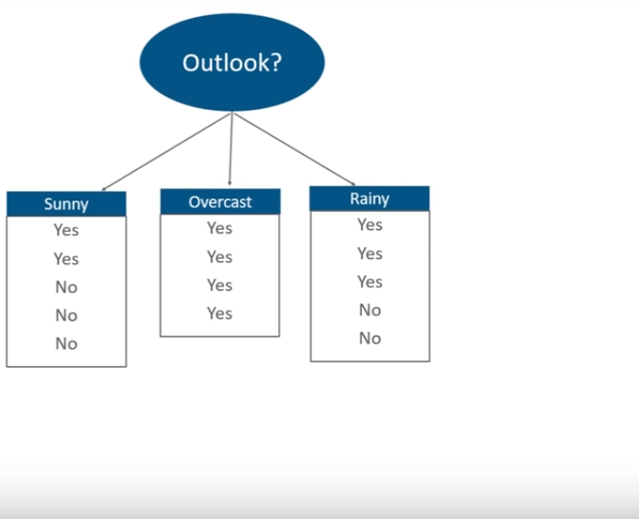
Calculated Entropy and Information Gain for Each Node
 | Outlook | Temp | Humid | Windy | Play
1 | sunny | hot | high | weak | no
2 | sunny | hot | high | strong | no
3 | overcast | hot | high | weak | yes
4 | rainy | mild | high | weak | yes
5 | rainy | cool | normal | weak | yes
6 | Rainy | cool | normal | strong | no
7 | Overcast | cool | normal | strong | yes
8 | sunny | mild | high | weak | no
9 | sunny | cool | normal | weak | yes
10 | rainy | mild | normal | weak | yes
11 | sunny | mild | normal | strong | yes
12 | overcast | mild | high | strong | yes
13 | overcast | hot | normal | weak | yes
14 | rainy | mild | high | strong | No
Start with
Y=2
N=3
Y=4
Y=3
N=2
Play

Slide 31
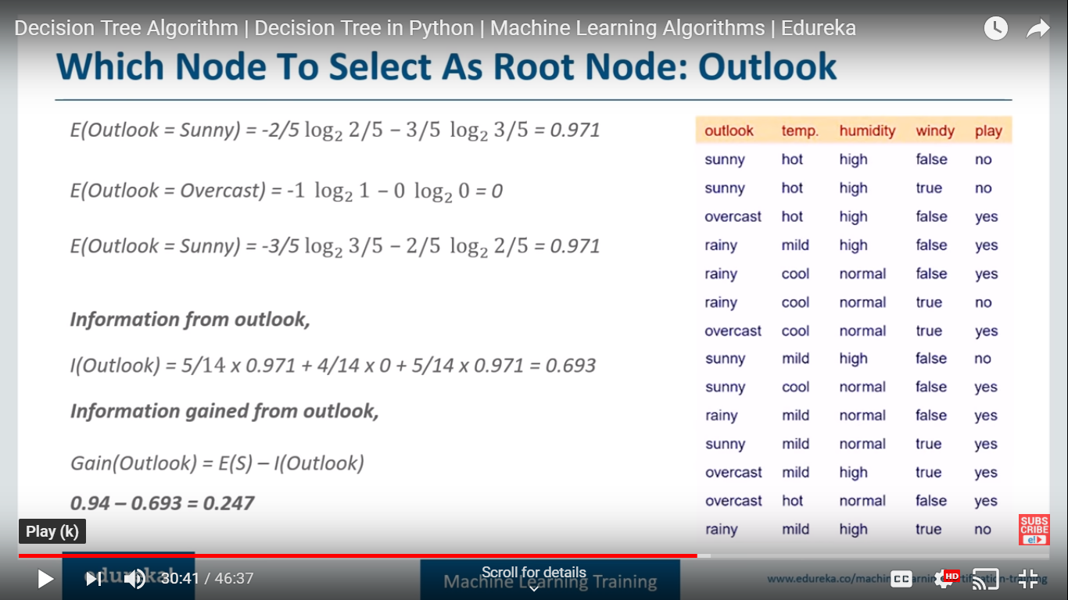
Which Node to select as Root Node: Outlook
Let us Consider Outlook as Node
0
Rainy

Slide 32
Information Gain for : Outlook
Weighted Avg (Sunny) = 5/14 , Entropy(Sunny) = .971
Sunny
Overcast
Rainy
0.247 = 0.94 – 0.693
Entropy of the datset

Slide 33
Which node to select as Root Node ? Windy
windy
 | Outlook | Temp | Humid | Windy | Play
1 | sunny | hot | high | weak | no
2 | sunny | hot | high | strong | no
3 | overcast | hot | high | weak | yes
4 | rainy | mild | high | weak | yes
5 | rainy | cool | normal | weak | yes
6 | Rainy | cool | normal | strong | no
7 | Overcast | cool | normal | strong | yes
8 | sunny | mild | high | weak | no
9 | sunny | cool | normal | weak | yes
10 | rainy | mild | normal | weak | yes
11 | sunny | mild | normal | strong | yes
12 | overcast | mild | high | strong | yes
13 | overcast | hot | normal | weak | yes
14 | rainy | mild | high | strong | No
Play
Yes=3
No=3
Yes=6
No=2

Slide 34
Information Gain for : Windy
 | Outlook | Temp | Humid | Windy | Play
1 | sunny | hot | high | weak | no
2 | sunny | hot | high | strong | no
3 | overcast | hot | high | weak | yes
4 | rainy | mild | high | weak | yes
5 | rainy | cool | normal | weak | yes
6 | Rainy | cool | normal | strong | no
7 | Overcast | cool | normal | strong | yes
8 | sunny | mild | high | weak | no
9 | sunny | cool | normal | weak | yes
10 | rainy | mild | normal | weak | yes
11 | sunny | mild | normal | strong | yes
12 | overcast | mild | high | strong | yes
13 | overcast | hot | normal | weak | yes
14 | rainy | mild | high | strong | No
E(Windy=Weak)=1
E(Windy=False)=0.811
Information from Windy:
I(Windy) = 8/14 x 0.811 + 6/14 x 1 = 0.892
Information Gain from Windy:
Gain(Windy) = E(S) - I(Windy)
0.048 = 0.94 -0.892

Slide 35
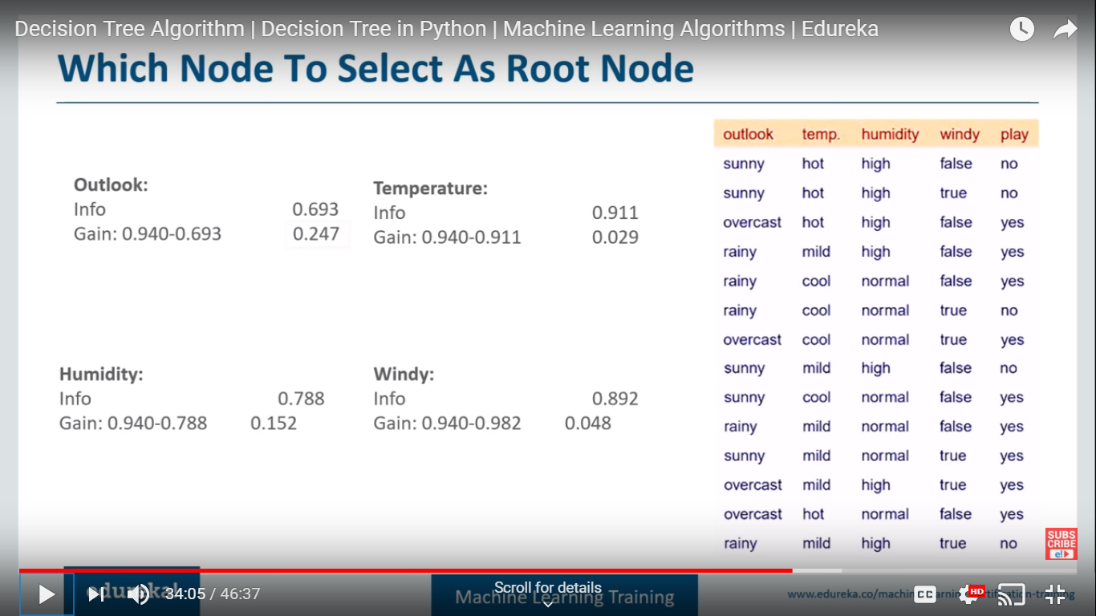
Calculate the Info Gain for all the nodes
 | Outlook | Temp | Humid | Windy | Play
1 | sunny | hot | high | weak | no
2 | sunny | hot | high | strong | no
3 | overcast | hot | high | weak | yes
4 | rainy | mild | high | weak | yes
5 | rainy | cool | normal | weak | yes
6 | Rainy | cool | normal | strong | no
7 | Overcast | cool | normal | strong | yes
8 | sunny | mild | high | weak | no
9 | sunny | cool | normal | weak | yes
10 | rainy | mild | normal | weak | yes
11 | sunny | mild | normal | strong | yes
12 | overcast | mild | high | strong | yes
13 | overcast | hot | normal | weak | yes
14 | rainy | mild | high | strong | No
Entropy of Total dataset : .940
Outlook has maximum gain so it is our root node

Slide 36
Select the Node with highest Info Gain: Outlook
 | Outlook | Temp | Humid | Windy | Play
1 | sunny | hot | high | weak | no
2 | sunny | hot | high | strong | no
3 | overcast | hot | high | weak | yes
4 | rainy | mild | high | weak | yes
5 | rainy | cool | normal | weak | yes
6 | Rainy | cool | normal | strong | no
7 | Overcast | cool | normal | strong | yes
8 | sunny | mild | high | weak | no
9 | sunny | cool | normal | weak | yes
10 | rainy | mild | normal | weak | yes
11 | sunny | mild | normal | strong | yes
12 | overcast | mild | high | strong | yes
13 | overcast | hot | normal | weak | yes
14 | rainy | mild | high | strong | No
Entropy of Total dataset : .940
Outlook has maximum gain so it is our root node

Slide 37
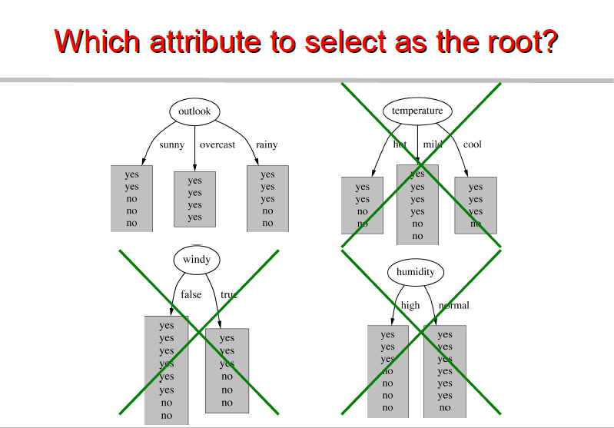
Select the node that gives more accurate answers

Slide 39
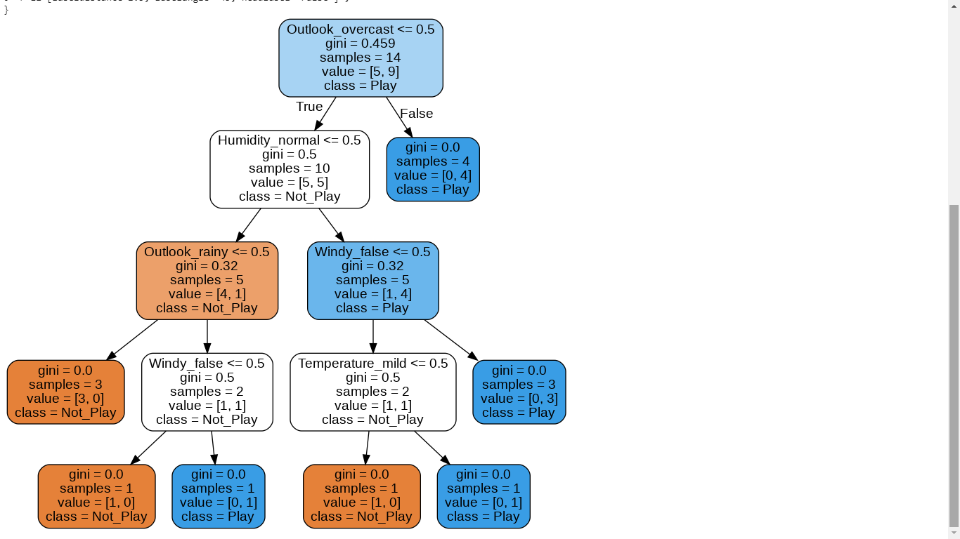

Slide 40
Gini is intended for continuous attributes, and Entropy for attributes that occur in classes.
Gini will tend to find the largest class, and entropy tends to find groups of classes that make up ~50% of the data.
Gini to minimize misclassification.
Entropy for exploratory analysis.
Some studies show this doesn’t matter – these differ less than 2% of the time.
Entropy may be a little slower to compute.

Slide 41
Gini Index

Slide 42
 | Outlook | Temp | Humid | Windy | Play
1 | sunny | hot | high | weak | no
2 | sunny | hot | high | strong | no
3 | overcast | hot | high | weak | yes
4 | rainy | mild | high | weak | yes
5 | rainy | cool | normal | weak | yes
6 | Rainy | cool | normal | strong | no
7 | Overcast | cool | normal | strong | yes
8 | sunny | mild | high | weak | no
9 | sunny | cool | normal | weak | yes
10 | rainy | mild | normal | weak | yes
11 | sunny | mild | normal | strong | yes
12 | overcast | mild | high | strong | yes
13 | overcast | hot | normal | weak | yes
14 | rainy | mild | high | strong | No

Slide 43
Gini Index
Gini index says, if we select two items from a population at random then they must be of same class and probability for this is 1 if population is pure.
It works with categorical target variable “Success” or “Failure”.
It performs only Binary splits
Higher the value of Gini higher the homogeneity.
CART (Classification and Regression Tree) uses Gini method to create binary splits.

Slide 44
Calucate Gini for a split
Calculate Gini for sub-nodes, using formula sum of square of probability for success and failure (p²+q²).
Calculate Gini for split using weighted Gini score of each node of that split

Slide 45
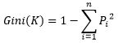
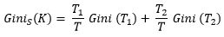
Gini index measures the impurity of a data partition K, formula for Gini Index can be written down as:
Where n is the number of classes, and P_{i} is the probability that an observation in K belongs to the class.
Gini Index assumes a binary split for each of the attribute in S, let say T₁ & T_{2.} The Gini index of K given this partitioning is given by:

Slide 46
Calculate Gini Index
So as the first step we will find the root node of our decision tree. For that Calculate the gini index of the class variable (Play)
Gini(S) = 1 - [(9/14)² + (5/14)²] = 0.4591

Slide 47
Gini Gain
we will calculate gini gain. For that first, we will find the average weighted gini impurity of Outlook, Temperature, Humidity and Windy.

Slide 48
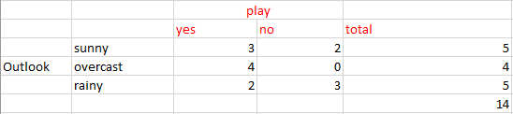
Gini Gain - Outlook
Gini(S, outlook) = (5/14)gini(3,2) + (4/14)*gini(4,0)+ (5/14)*gini(2,3) = (5/14)(1 - (3/5)² - (2/5)²) + (4/14)*0 + (5/14)(1 - (2/5)² - (3/5)²)= 0.171+0+0.171 = 0.342
Gini gain (S, outlook) = 0.459 - 0.342 = 0.117
Gini Index : Play

Slide 49
Gini Gain – For all Predictors
Gini gain (S, outlook) = 0.459 - 0.342 = 0.117
Gini gain(S, Temperature) = 0.459 - 0.4405 = 0.0185
Gini gain(S, Humidity) = 0.459 - 0.3674 = 0.0916
Gini gain(S, windy) = 0.459 - 0.4286 = 0.0304
Choose one that having higher gini gain.
Gini gain is higher for outlook .So we can choose it as our root node.

Slide 50
Split on Which Column?
Above, you can see that Gini score for Split on Outlook (0.117) is higher than Split on other Classes(Columns) hence, the node split will take place on Outlook

Slide 51
Gini Vs Entropy

Slide 52
Gini Vs Entropy
The Gini Index is calculated by subtracting the sum of the squared probabilities of each class from one. It favours larger partitions.
Information Gain multiplies the probability of the class times the log (base=2) of that class probability. Information Gain favors smaller partitions with many distinct values.
Ultimately, you have to experiment with your data and the splitting criterion.

Slide 53
End

Slide 54
Random Forest

Slide 55
Definitions
The Random Forest is a model made up of many decision trees. Rather than just simply averaging the prediction of trees (which we could call a “forest”)
This model uses two key concepts that gives it the name random:
Random sampling of training data points when building trees
Random subsets of features considered when splitting nodes

Slide 56
Random Forest
It is a Ensemble methods, which combines several decision trees to produce better predictive performance than utilizing a single decision tree
The random forest combines hundreds or thousands of decision trees, trains each one on a slightly different set of the observations, splitting nodes in each tree considering a limited number of the features.
The final predictions of the random forest are made by averaging the predictions of each individual tree.

Slide 57
Random Forest
The first step in Random Forest is that it will divide the data into smaller subsets
Every subset need not be distinct, some may overlap
For each subset a decision tree is made

Slide 58
Random sampling of training observations
Each tree in a random forest learns from a random sample of the data points
The samples are drawn with replacement, known as bootstrapping, which means that some samples will be used multiple times in a single tree
At test time, predictions are made by averaging the predictions of each decision tree
This procedure of training each individual learner on different bootstrapped subsets of the data and then averaging the predictions is known as bagging, short for bootstrap aggregating.

Slide 59
 | Outlook | Temp | Humid | Windy | Play
1 | sunny | hot | high | weak | no
2 | sunny | hot | high | strong | no
3 | overcast | hot | high | weak | yes
4 | rainy | mild | high | weak | yes
5 | rainy | cool | normal | weak | yes
6 | Rainy | cool | normal | strong | no
7 | Overcast | cool | normal | strong | yes
8 | sunny | mild | high | weak | no
9 | sunny | cool | normal | weak | yes
10 | rainy | mild | normal | weak | yes
11 | sunny | mild | normal | strong | yes
12 | overcast | mild | high | strong | yes
13 | overcast | hot | normal | weak | yes
14 | rainy | mild | high | strong | No

Slide 60
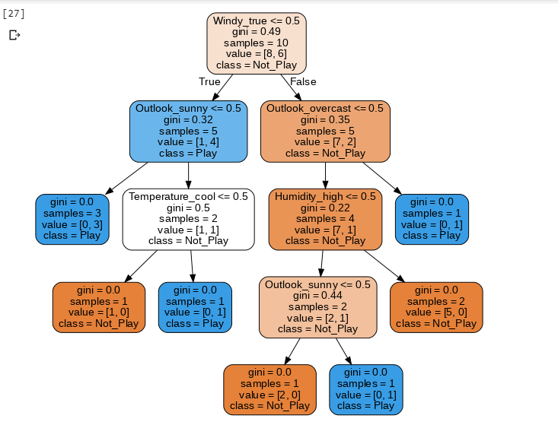

Slide 61
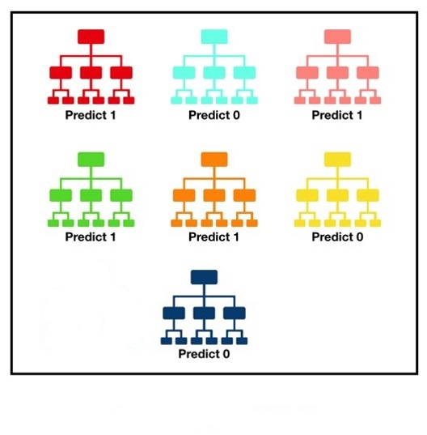
Tally: four 1s and three 0s
Prediction = 1
Notes:
The reason for this wonderful effect is that the trees protect each other from their individual errors

Slide 62
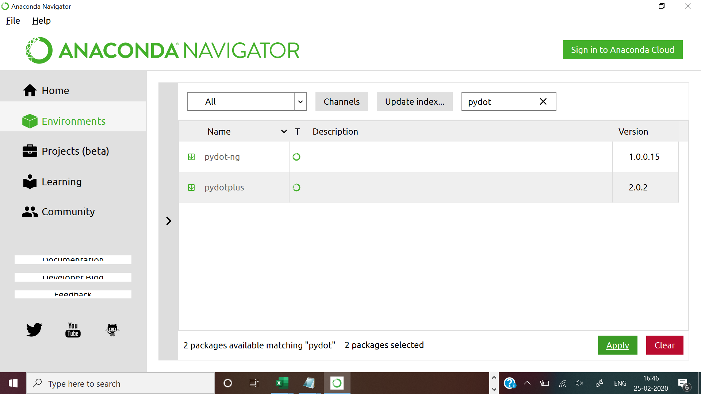
For using pydotplus in python for decision tree graphs

Slide 63
End

